Slide 1
Project Components
Overall Objectives of the Project:
COMPONENT-1: Inception report (Finalization of methodology and Work Plan)
COMPONENT-2: Detailed Literature Review and its summery and lessons learnt;
COMPONENT-3: Development of input datasets for models of the long-term physical processes
COMPONENT-4: Modeling of the long-term physical processes in the coastal zone;
COMPONENT-5: Finalization of approach for reconstruction of the Polder at different coastal zones including their phasing and construction program;
COMPONENT-6: Updating of design parameters and specifications for planning & design works; review of approaches for management of polders with active participation of beneficiaries and stake holders;
COMPONENT-7: Investment plan for the entire CEIP;
COMPONENT-8: Action plan for Capacity Building of concerned professionals and relevant stake holders in planning, design and management of the polders.
COMPONENT-9: Outreach and communication strategy
COMPONENT-3: Development of input datasets for models of the long-term physical processes

Slide 2
Componenet-3 - Objective
Componenet-3: Objective
Development of an Interactive Polder Database System for Research, Monitoring, and Analyses of Bangladesh Coastal Zone towards long term sustainable polder development and management with attention to geo-morphological, environmental, economic and ecological aspects.
The database will help in long-term monitoring of polder situation after any project intervention:
Status of physical features (polders/embankments, cannel/channels, protective works, hydraulic structures etc.
Land use Change
Hydro-morphological Change
Change of Socio-Economic scenarios
Agricultural
poverty levels,
education and communication facilities etc.

Slide 3
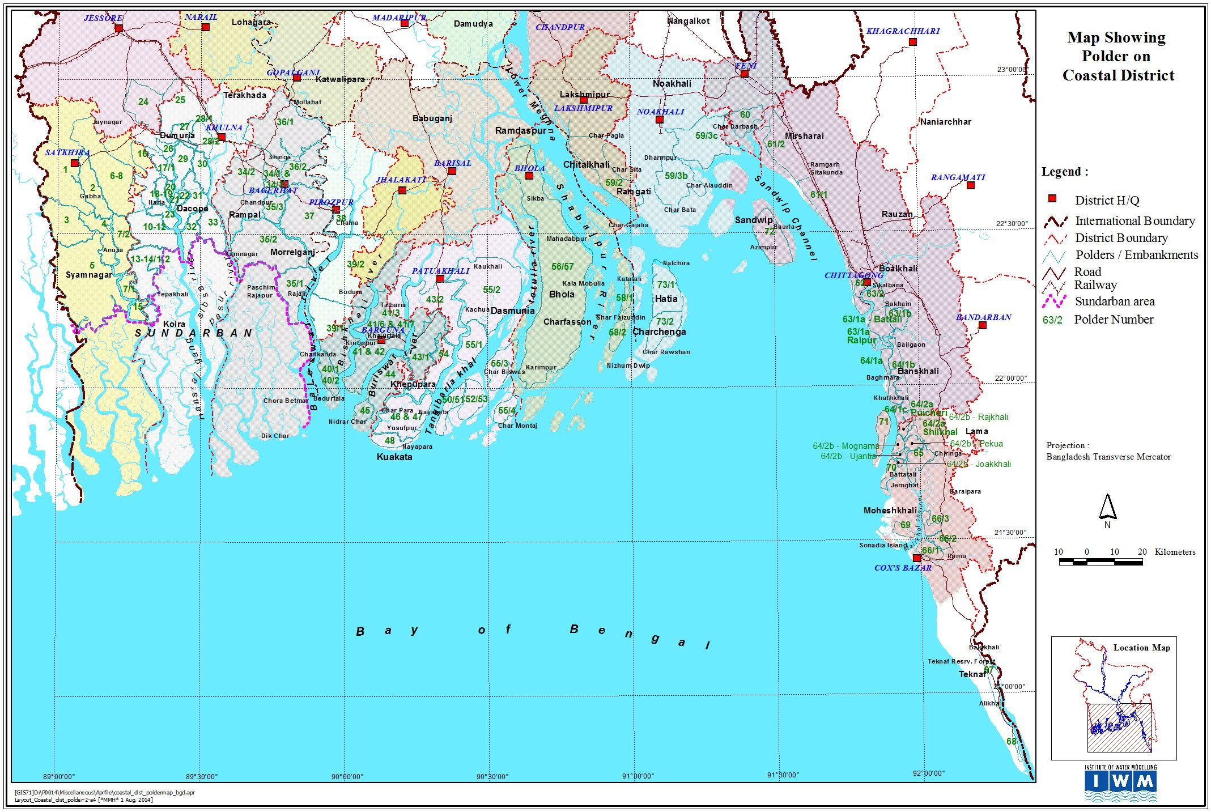
Coastal Region Of Bangladesh
710 Km Coastline
35,000 Km2 (approx.)
62% <3m elevation
83% within 5m elevation
32% of land hosts 28% of population (42 Million)
Source: Project Inception Report
Polder Location Map

Slide 4
IGDCZ-Database Contents
General Admin Boundaries
Division
District
Upazila
Union
BWDB Boundaries
Zone
Circle
Division
CEIP Project Boundary
Natural
Rivers
Bay of Bengal
BoB Bottom Elevation
BoB Bottom Contour
BoB Bottom Surface
Polder Elevation
Contour
DEM
Salinity Surface
Soil Lithology
Wetlands and waterbodies
Forest
River (centerline)
River Polygon
Morphological
River erosion
Coastal Erosion & Accretion
Bathymetry (Coastal and River)
Hydro-meteorological
Surface water level (Tidal & non-tidal)
River discharge
Ground water levels
Rainfall
Sediment Observation
Cyclone Track
Demographic/Socio-economic
Population
Literacy
Cyclone Shelter
Environmental
Bio-diversity
Arsenic Contamination in Groundwater
Agriculture
Agricultural Land Use (Rabi, Kharif-1 & Kharif-2)
Interventions
Polders
Embankments
Embankment
Embankment Cross-Section
Hydraulic Structures
Protective works
Canals
Canal/River Cross Section
River Bathymetry
Settlement
Roads, Bridge / Culverts
BIWTA Navigation Route
Impacts/Model Results (to be included
Flooding and inundation
Drought
Subsidence
Physiography
Physiographic features from AEZ Map
Land use Change (1990-2020)
Document Archive
Metadata
Total Layers: 52

Slide 5
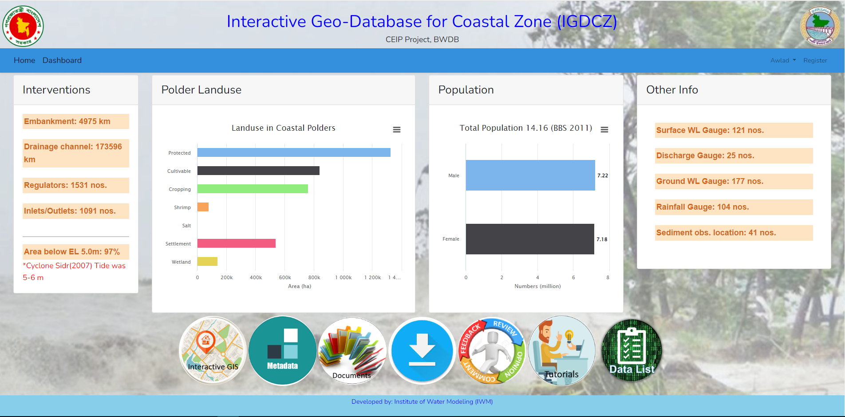
IGDCZ Dashboard

Slide 6
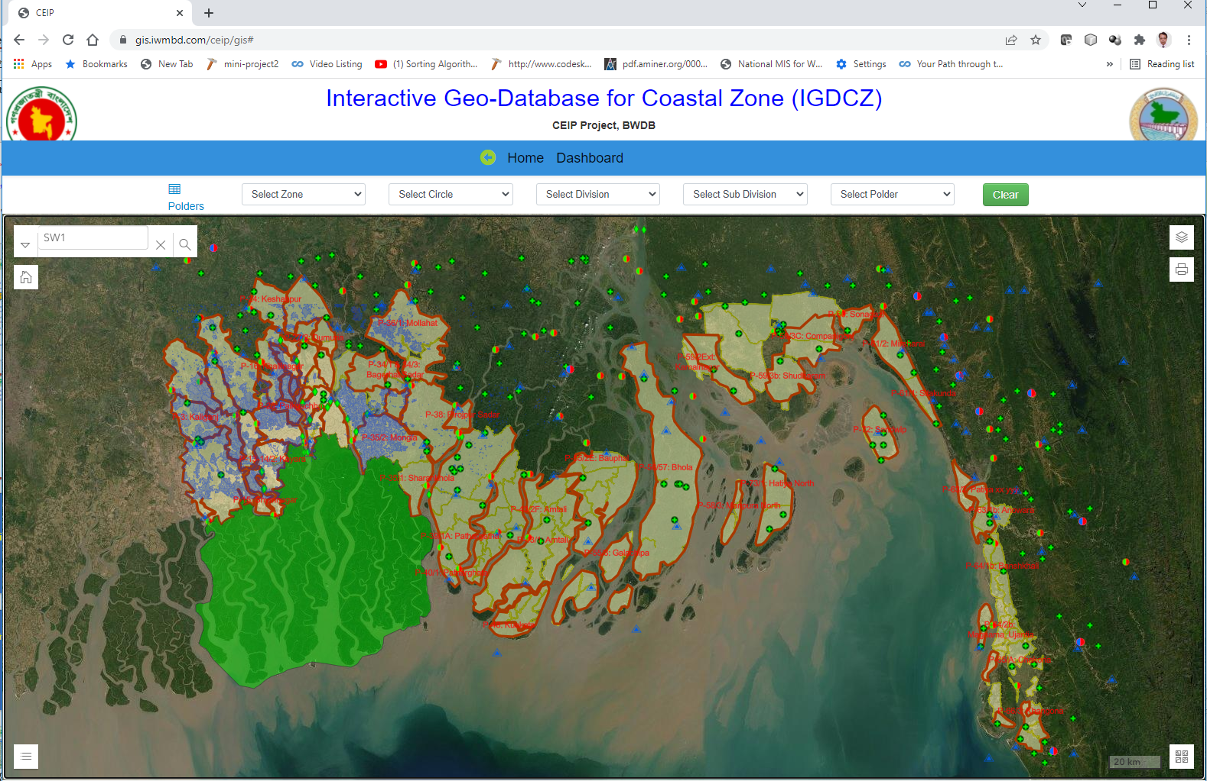
IGDCZ Database
A Web GIS base Interactive Geodatabase for Coastal Zone (IGDCZ) database System has been developing with more than 50 numbers of layers and datasets of physical features, land use, hydro-meteorological, hydro-morphological changes, agricultural and socio-economic and ecological aspects in the Coastal Zone in Bangladesh.
IGDCZ Modules/Features:
User Login Interface
Dashboard
Interactive GIS
Document Archive
Metadata
Download for data export
User Feedback
Tutorial for user manual
List of datasets/layers
Development platform:
GIS Services and GIS Interface: ArcGIS Enterprise Software
Database: Oracle & PostgreSQL
OS: Windows
Front End Tools: HTML5, CSS, JavaScripts, ArcGIS APIs etc.
Backend: Laravel

Slide 7
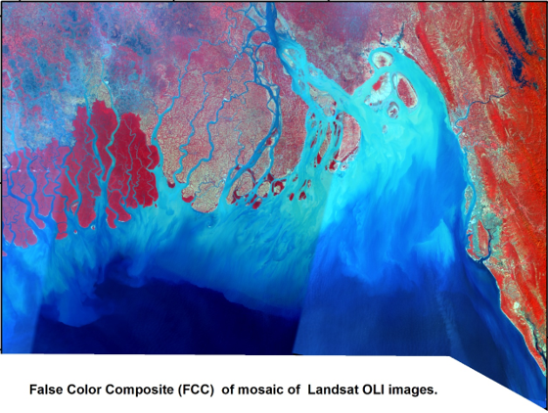
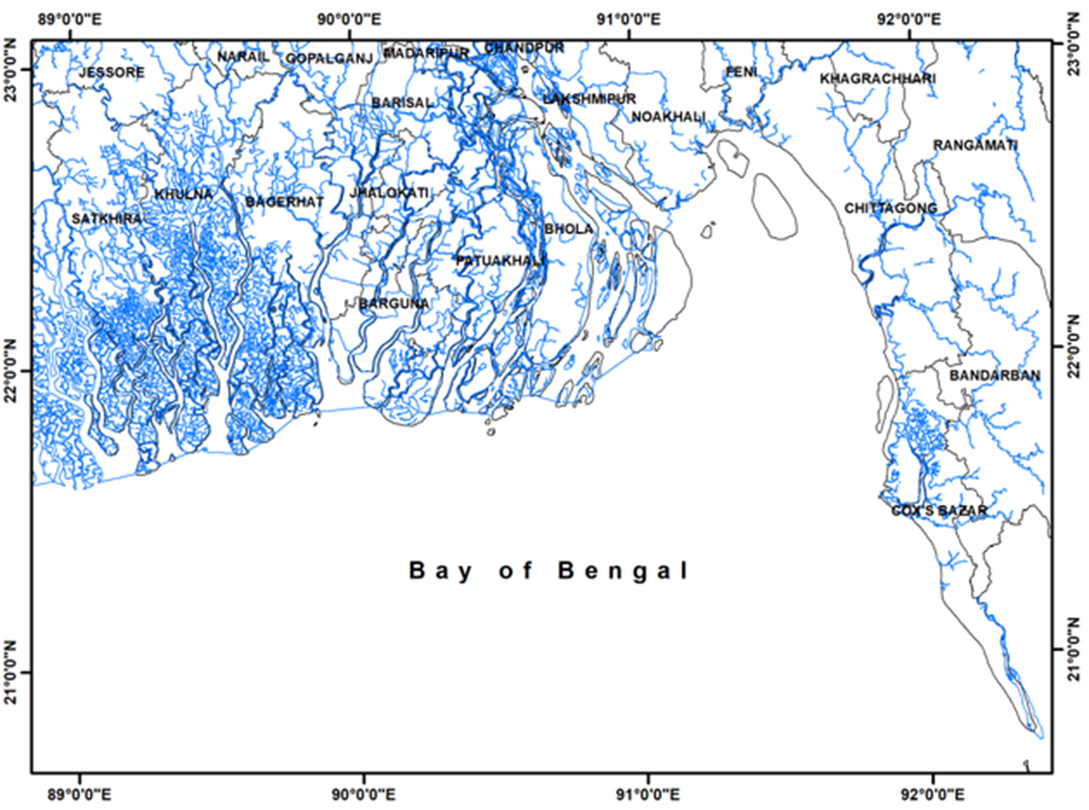
Erosion-Accretion of Bank lines (1989-2020)
The coastal area of Bangladesh is morphologically dynamic
Erosion and accretion are very frequent along the coast
LandSat Images were utilized
Image Resolution: 30m
Study used Satellite images captured in dry season
OLI: Operational Land Imager is a remote sensing instrument aboard Landsat 8

Slide 8
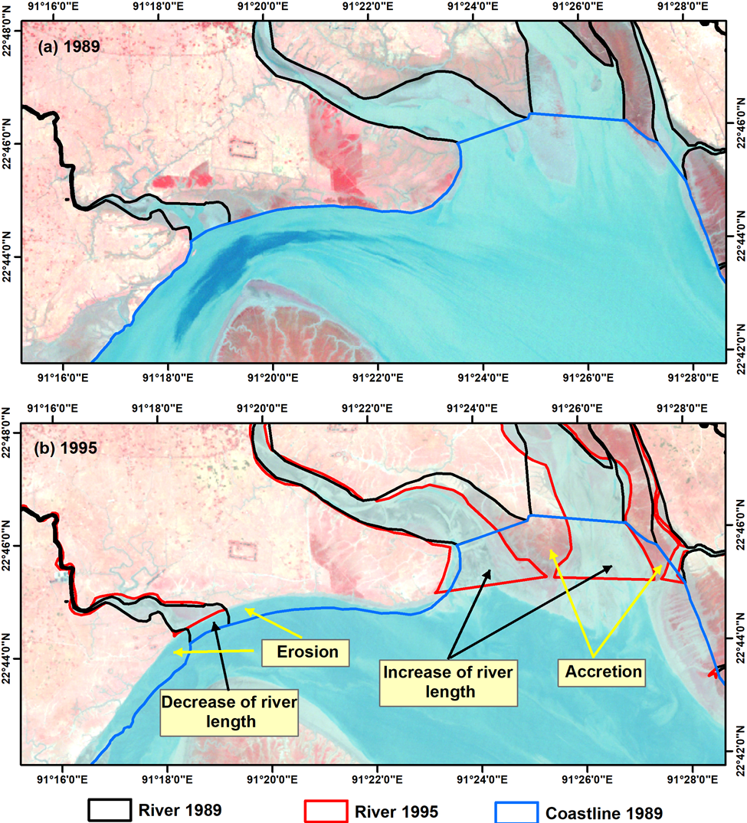
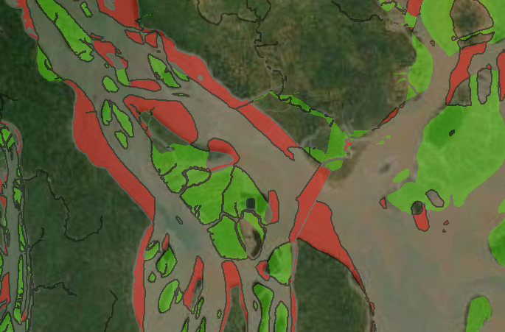
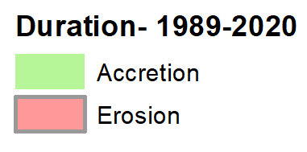
Erosion-Accretion of Bank lines (1989-2020)
Changes were extracted from satellite images of 1989, 1995, 2000, 2005, 2010, 2015 and 2020.
Erosion-Accretion 1989-2020

Slide 9
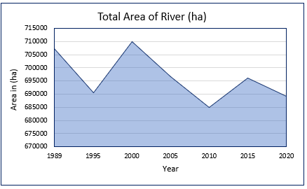
Erosion-Accretion of Bank lines (1989-2020)
Area Statistics in Coastal Erosion and Accretion
Year | Total River Area (ha) | Duration | Erosion (ha) | Accretion (ha) | Net Area (ha)
1989 | 7,07,197 | - | - | - | -
1995 | 6,90,649 | 1989-1995 | 25,938 | 43,369 | +17,431
2000 | 7,09,856 | 1995-2000 | 44,133 | 23,428 | -20,705
2005 | 6,96,600 | 2000-2005 | 29,576 | 42,893 | +13,317
2010 | 6,84,863 | 2005-2010 | 28,579 | 38,906 | +10,327
2015 | 6,96,025 | 2010-2015 | 44,494 | 33,544 | -10,950
2020 | 6,89,313 | 2015-2020 | 35,470 | 40,291 | +4,821
- |  | 1989-2020 | 115090 | 132975 | +17,885

Slide 10
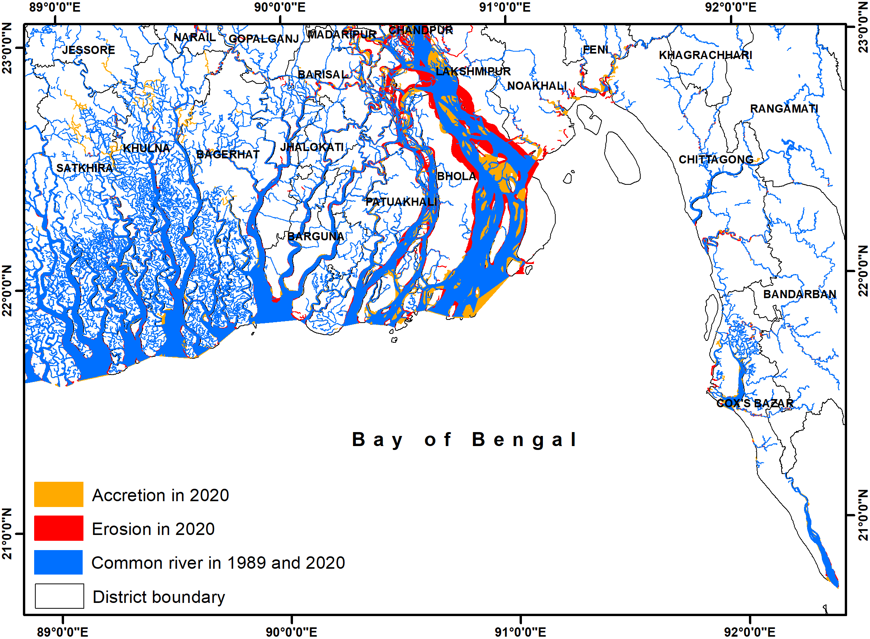
Erosion-Accretion of Bank lines (1989-2020)
Overall
Duration : 1989-2020
Erosion (ha) : 115090
Accretion (ha) : 132975

Slide 11
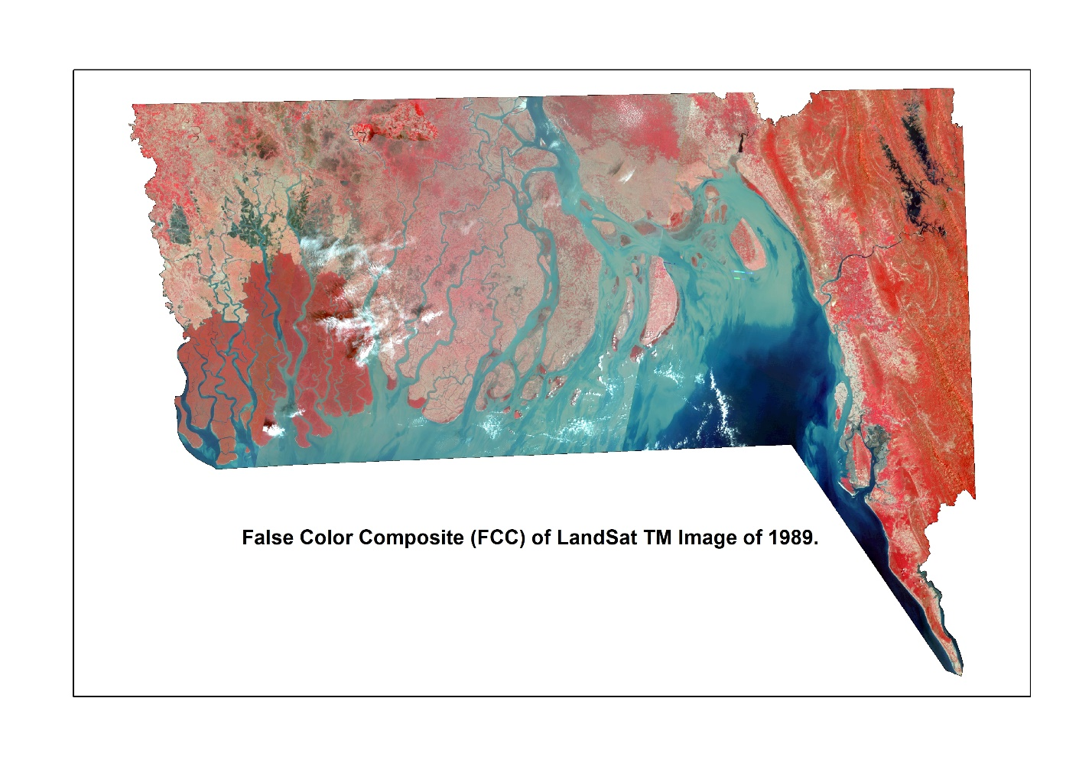
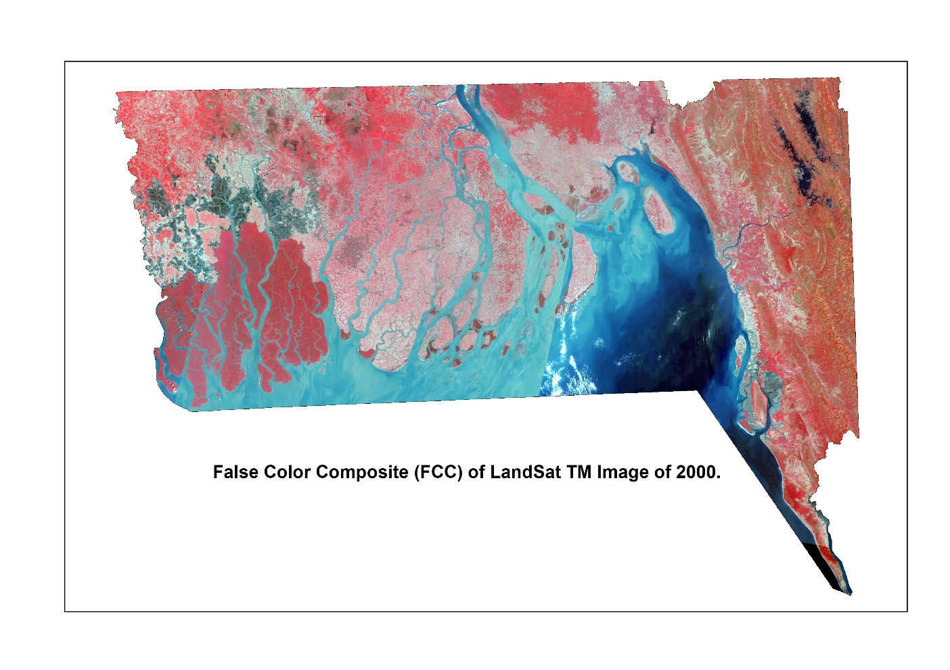
Satellite Image Classification
Satellite mosaic images of 1989, 2022, and 2020
Satellite/Sensor | Year | Frame | Date of image
Landsat/TM | 1989 | 138-44, 138-45 | 16/03/1989
 |  | 137-44, 137-45 | 09/03/1989
 |  | 136-44, 136-45, 136-46 | 16/03/1989
 |  | 135-45, 135-46 | 14/01/1989
 | 2000 | 138-44, 138-45 | 11/02/2000, 28/03/1999
 |  | 137-44, 137-45 | 28/02/2000, 21/03/1999
 |  | 136-44, 136-45, 136-46 | 13/02/2000, 19/3/2001
 |  | 135-45, 135-46 | 22/02/2000
Landsat/OLI | 2020 | 138-44, 138-45 | 03/03/2019
 |  | 137-44, 137-45 | 30/03/2020
 |  | 136-44, 136-45, 136-46 | 23/03/2020
 |  | 135-45, 135-46 | 16/03/2020
Image Resolution: 30 meter

Slide 12
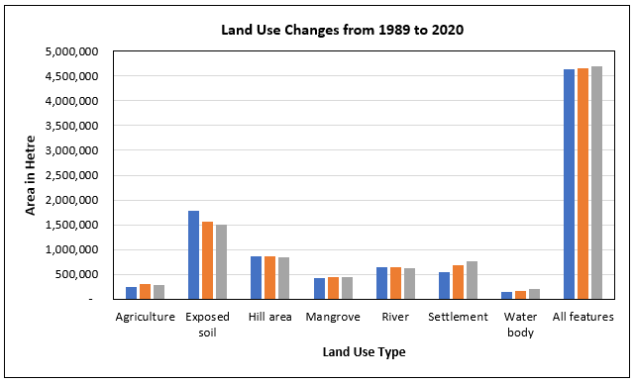
Land Use Change
Land Use Changes from 1989 to 2020
Landuse Feature | Area, Hectares |  |  | Overall Changes
 | 1989 | 2000 | 2020 | 1989-2000, Hectares | % w.r.t 1989 | 2000-2020, Hectares | % w.r.t 2000
Agriculture | 239742 | 304543 | 293626 | 64801 | 27.03 | -10917 | -3.58
Exposed soil | 1791445 | 1567108 | 1511258 | -224337 | -12.52 | -55851 | -3.56
Hill area | 855352 | 854853 | 850427 | -499 | -0.06 | -4426 | -0.52
Mangrove | 430701 | 443560 | 440552 | 12860 | 2.99 | -3009 | -0.68
River | 642105 | 646481 | 629299 | 4376 | 0.68 | -17182 | -2.66
Settlement | 540094 | 680458 | 761273 | 140364 | 25.99 | 80815 | 11.88
Water body | 145732 | 167821 | 206611 | 22089 | 15.16 | 38790 | 23.11
All features | 4645171 | 4664825 | 4693046 | 19654 | 0.42 | 28221 | 0.60

Slide 13
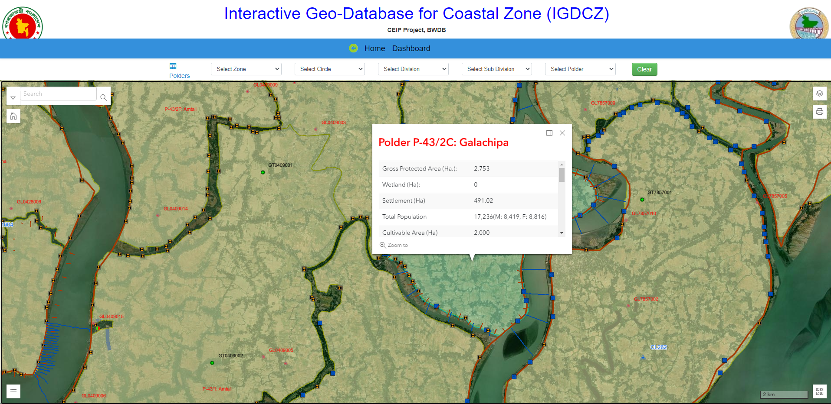
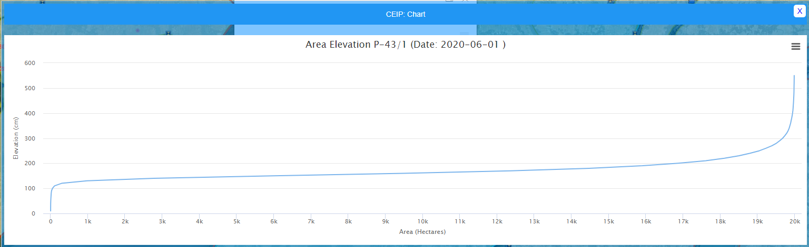
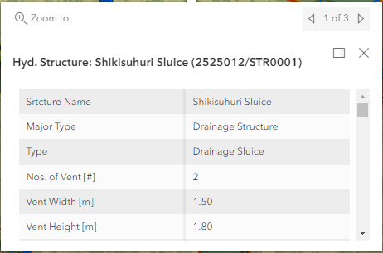
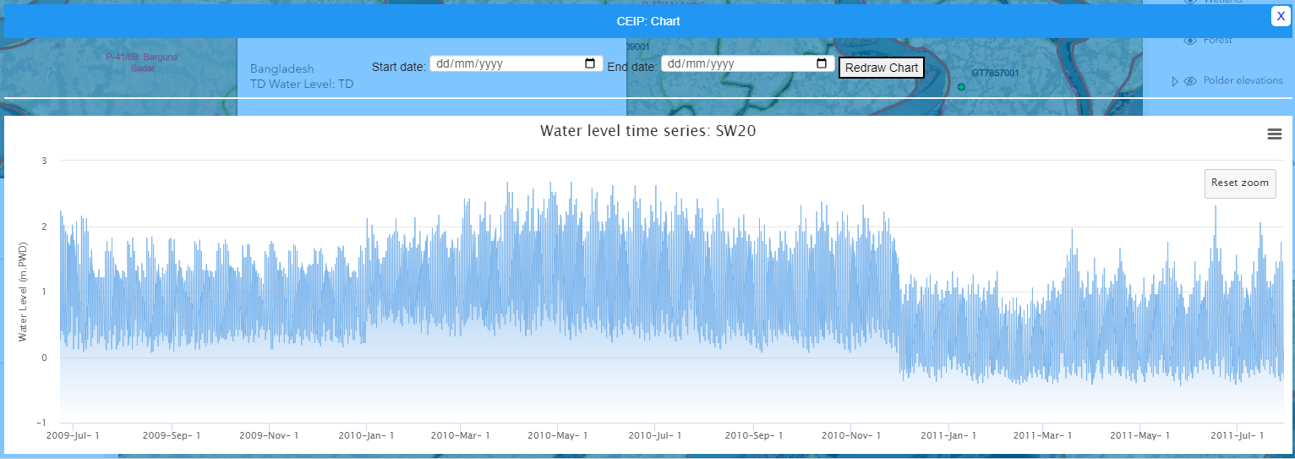
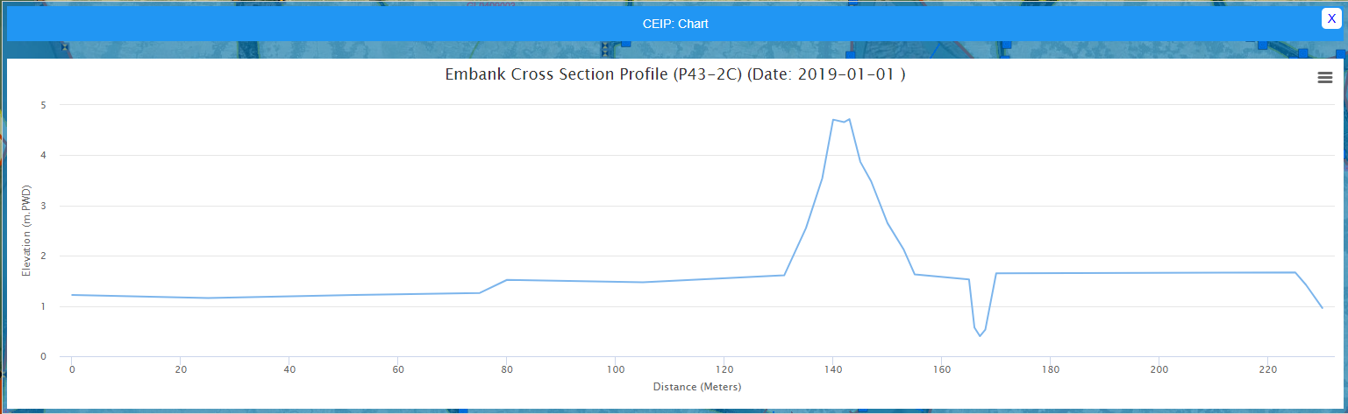
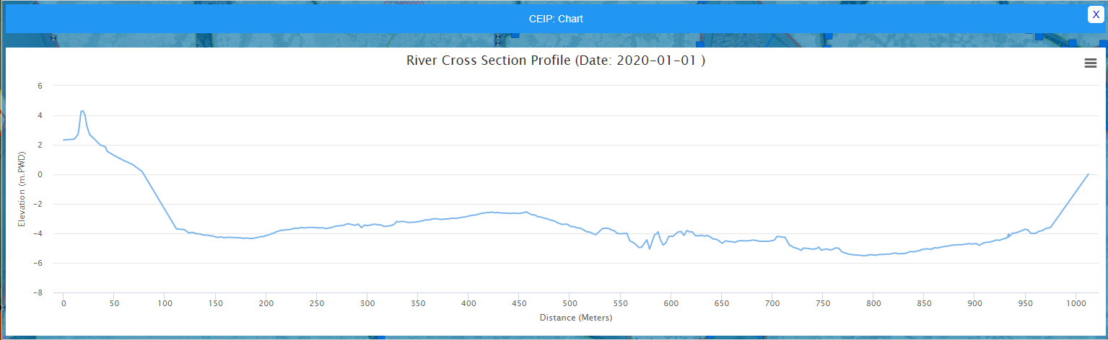
Some Snapshots

